Slide 1


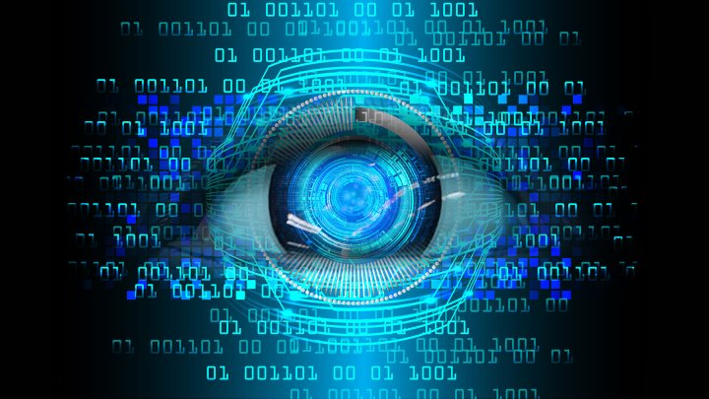
Python Programming
Prepared by Isaac Kamau
+254704205553 |linkedin.com/in/isaak-mwangi/

Slide 2
Welcome to the world of Python programming! In this introductory course, we will embark on a journey to explore the fundamentals of Python, a versatile and powerful programming language. Whether you're a complete beginner or have some prior coding experience, this course will lay a solid foundation for your Python journey.
Python has gained immense popularity due to its simplicity, readability, and extensive community support. It serves as an excellent language for beginners while also being widely used in industry and various domains such as web development, data analysis, artificial intelligence, and more. Its intuitive syntax and vast range of libraries make it a go-to choice for developers worldwide.

Slide 3
Throughout this course, we will cover the core concepts of Python, starting from basic syntax and data types to more advanced topics like functions, loops, file handling, and object-oriented programming. We will dive into practical examples and hands-on exercises to solidify your understanding and provide you with the tools to write efficient and elegant Python code.
By the end of this course, you will have a solid understanding of Python's key concepts and be equipped to tackle real-world programming challenges. Python's simplicity and readability make it an excellent language for beginners, while its versatility and extensive libraries ensure it remains a powerful tool for professional developers.
So, let's embark on this exciting journey into the world of Python programming, where you'll unlock the potential to bring your ideas to life through code. Get ready to dive in and explore the limitless possibilities that Python has to offer!

Slide 4
In this session, we are shall be covering:
Python Programming Basics
Python language advantages and applications.
Download and Install Python IDE
Use and Installation of Jupyter Notebook as a Python platform.

Slide 5
What is python?
Python is a popular programming language. It was created by guido van rossum, and released in 1991.
What can python do?
Python can be used on a server to create web applications.
Python can be used alongside software to create workflows.
Python can connect to database systems. It can also read and modify files.
Python can be used to handle big data and perform complex mathematics.
Python can be used for rapid prototyping, or for production-ready software development.

Slide 6
Why Python?
Python works on different platforms (windows, mac, linux, raspberry pi, etc).
Python has a simple syntax similar to the english language.
Python has a syntax that allows developers to write programs with fewer lines than some other programming languages.
Python runs on an interpreter system, meaning that code can be executed as soon as it is written. This means that prototyping can be very quick.
Python can be treated in a procedural way, an object-oriented way or a functional way.
Good to know
The most recent major version of python is python 3, which we shall be using. However, python 2, although not being updated with anything other than security updates, is still quite popular. It is possible to write python in an integrated development environment, such as thonny, pycharm, netbeans or eclipse which are particularly useful when managing larger collections of python files. In our case we will be using pycharm and anaconda as our IDE

Slide 7
Python Install
Many PCs and Macs will have python already installed.
To check if you have python installed on a Windows PC, search in the start bar for Python or run the following on the Command Line (cmd.exe):
C:\Users\Your Name>python --version
To check if you have python installed on a Linux or Mac, then on Linux open the command line or on Mac open the Terminal and type:
python --version
If you find that you do not have Python installed on your computer, then you can download it for free from the following website: https://www.python.org/

Slide 8
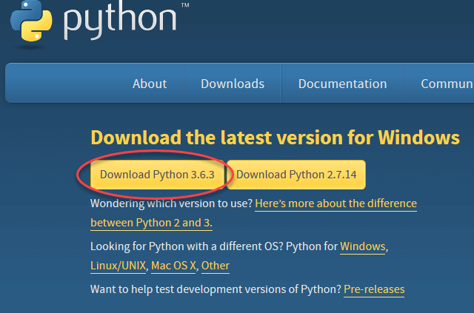
Install Python
To download and install Python, visit the official website of Python https://www.python.org/downloads/ and choose your version. We will be using Python Version 3.11.2 but for demonstration purposes, We have used Python version 3.6.3

Slide 9
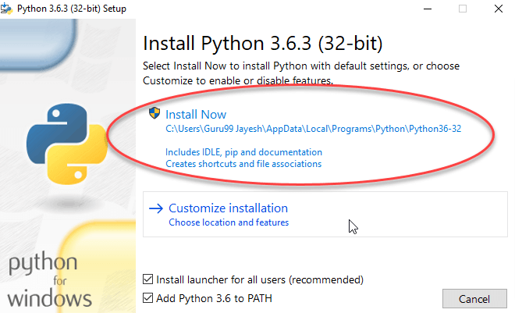
2. Once the download is completed, run the .exe file to install Python. Now click on Install Now.

Slide 10
Python Integrated development environment // IDE: (Pycharm,vsc, Juypter Notebook, IDLE, CMD)

Slide 11
Python IDLE
What Is Python IDLE?
Every Python installation comes with an Integrated Development and Learning Environment, which you’ll see shortened to IDLE or even IDE. These are a class of applications that help you write code more efficiently. While there are many IDEs for you to choose from, Python IDLE is very bare-bones, which makes it the perfect tool for a beginning programmer.
Python IDLE comes included in Python installations on Windows and Mac. If you’re a Linux user, then you should be able to find and download Python IDLE using your package manager. Once you’ve installed it, you can then use Python IDLE as an interactive interpreter or as a file editor.

Slide 12
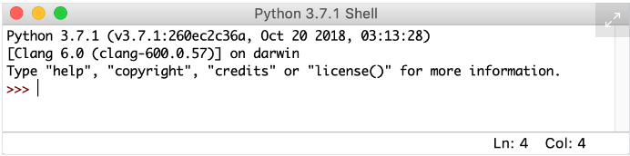
How to Use the Python IDLE Shell:
The shell is the default mode of operation for Python IDLE. When you click on the icon to open the program, the shell is the first thing that you see

Slide 13
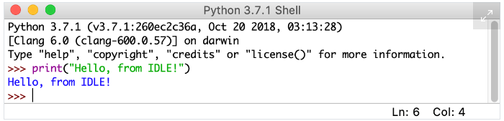
This is a blank Python interpreter window. You can use it to start interacting with Python immediately. You can test it out with a short line of code as follows

Slide 14
3. Install PyCharm:
PyCharm is a cross-platform editor developed by JetBrains. Pycharm provides all the tools you need for productive Python development.
Check System requirements here: https://www.jetbrains.com/help/pycharm/installation-guide.html#requirements
For Windows follow this link: https://www.jetbrains.com/pycharm/download/#section=windows
For MacOS follow this link: https://www.jetbrains.com/pycharm/download/#section=mac
For Linux OS follow this link: https://www.jetbrains.com/pycharm/download/#section=linux
Once the download is complete, run the exe for install PyCharm. The setup wizard should have started. Click “Next”.

Slide 15
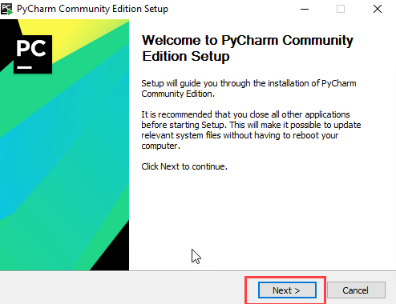

Slide 16
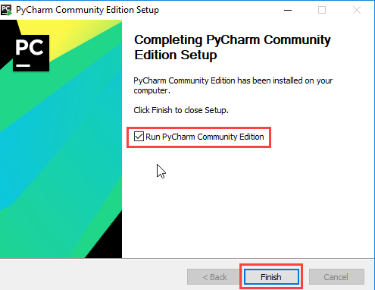
Proceed with the DEFAULT installation. Once installation finished, you should receive a message screen that PyCharm is installed. If you want to go ahead and run it, click the “Run PyCharm Community Edition” box first and click “Finish”.

Slide 17
Create your First Python Program
To create a new project, click on “Create New Project”. On the introductory screen of the Pycharm
You will need to select a location.
You can select the location where you want the project to be created. If you don’t want to change location than keep it as it is but at least change the name from “untitled” to something more meaningful, like “FirstProject”.
PyCharm should have found the Python interpreter you installed earlier.
Next Click the “Create” Button.

Slide 18
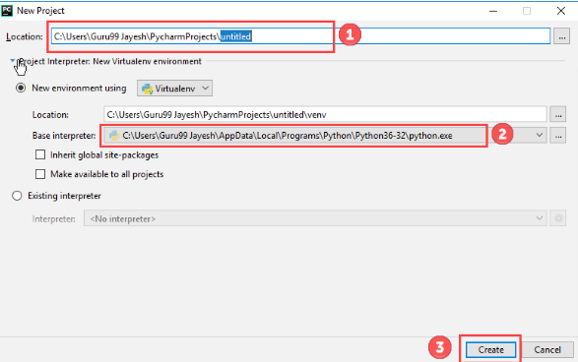

Slide 19
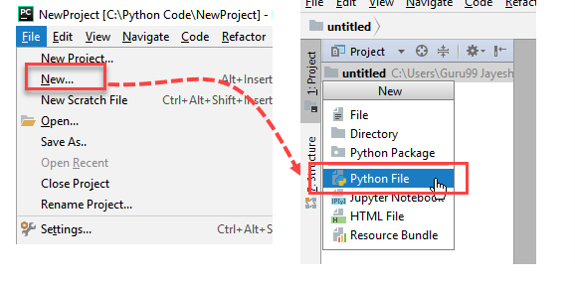

Slide 20
A new pop-up will appear. Now type the name of the file you want (Here we give “HelloWorld”) and hit “OK”.
Now go to the “Run” menu and select “Run” to run your program.

Slide 21
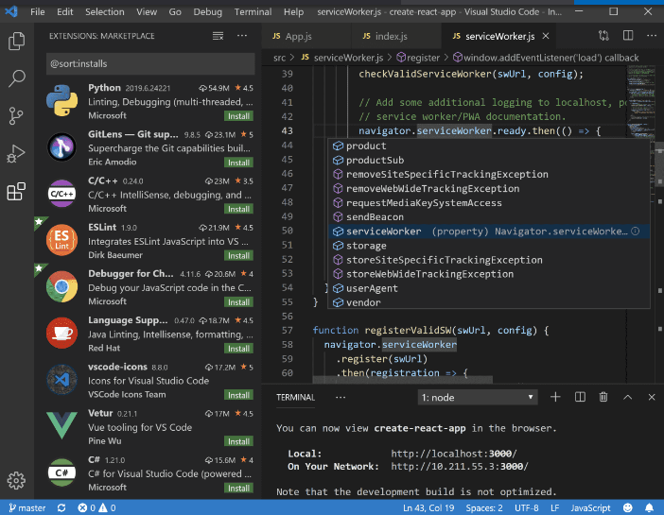
VISUAL STUDIO CODE

Slide 22
Installing Visual Studio Code:
Follow this link https://code.visualstudio.com/download
Visual Studio Code, also commonly referred to as VS Code, is a source-code editor made by Microsoft with the Electron Framework, for Windows, Linux, and macOS. Features include support for debugging, syntax highlighting, intelligent code completion, snippets, code refactoring, and embedded Git.

Slide 23
The Python Command Line
if you don’t have Pycharm Editor/Jupyter installed, you can still run the code from the command prompt. Enter the correct path of a file in the command prompt to run the program.

Slide 24
Windows CMD Command
What Is CMD
CMD stands for Command (.CMD). A command is an instruction given to a computer program that tells the program what has to be done. It is an application that is found in most computers with Windows as the Operating System, and it helps in the execution of the commands entered. It is also called Command Prompt or Windows Command Processor.
Why Is Command Prompt Useful
Command prompt has become increasingly popular with people having no background in IT as it helps to automate several tedious, mundane tasks with the help of a few clicks. The interface allows the user to run multiple commands, and the commands can be executed one after the other. This has proved a boon in the world of automation.
Most users find it difficult to learn and cannot use Command prompt as compared to the user-friendly interface that is available on the modern apps, however, Command prompt can still be used in many situations.

